Slide 1
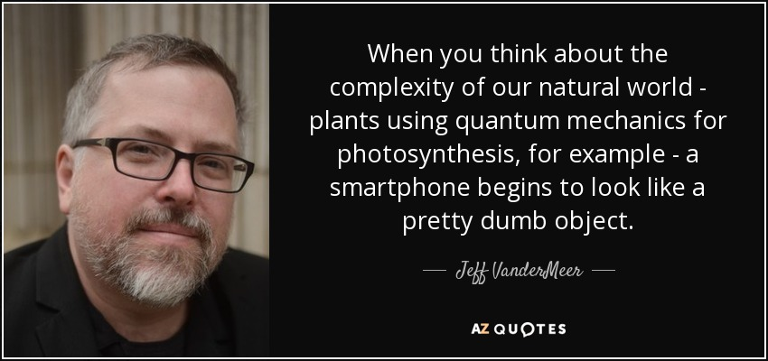

Slide 2
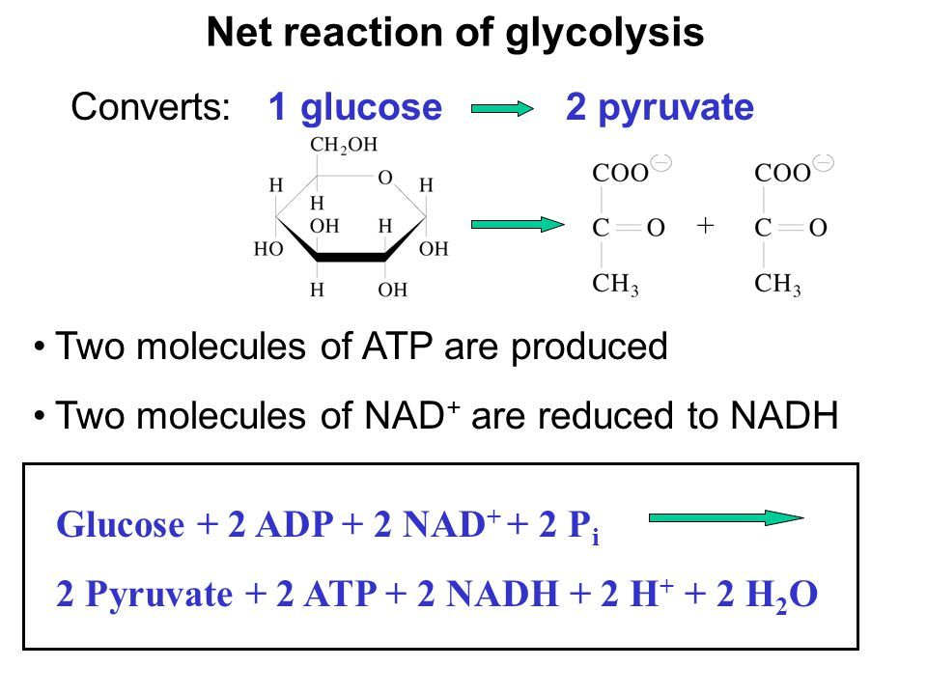
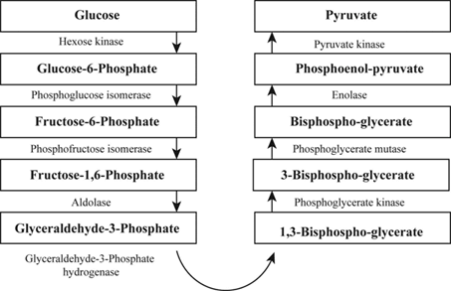
Major steps in Glycolysis

Slide 3
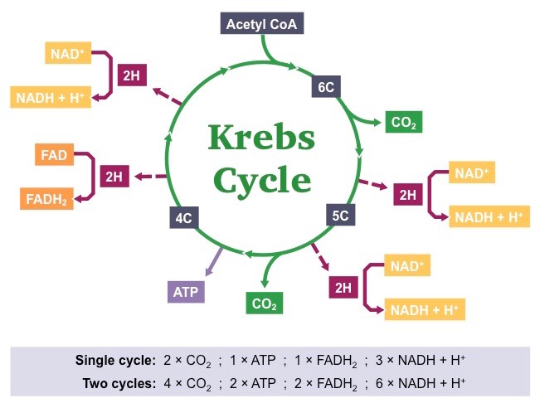
By products of TCA cycle

Slide 4
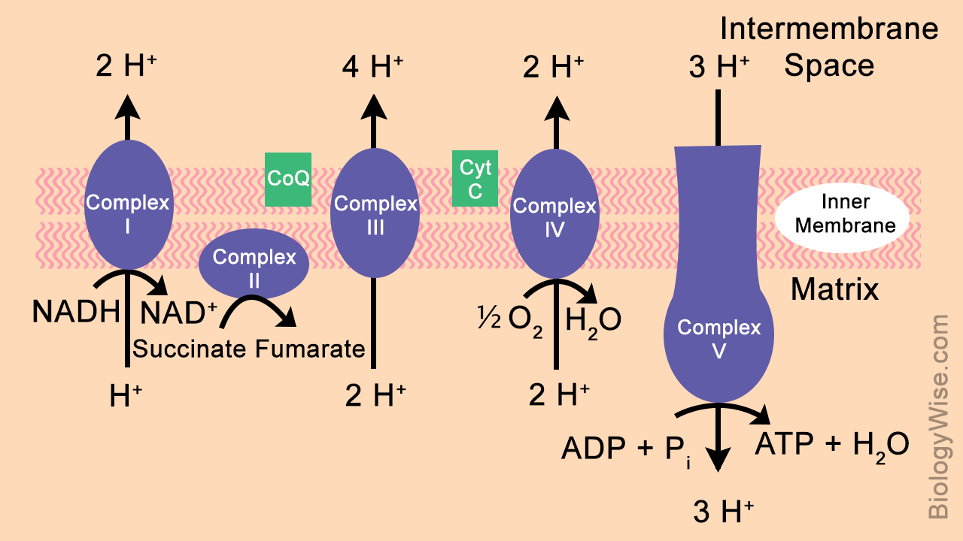
The electron transport chain-details

Slide 5
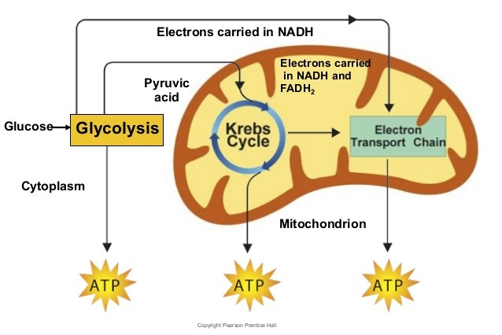
Overview of Cellular Respiration

Slide 6
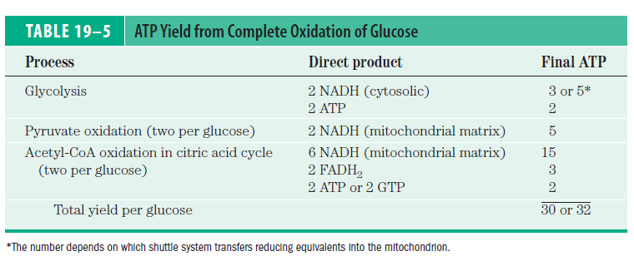
Energy from one molecule of Glucose

Slide 7
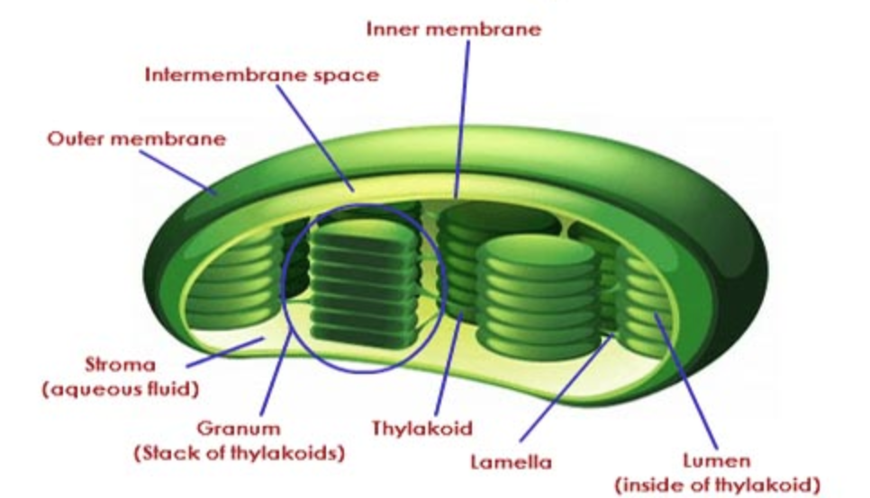
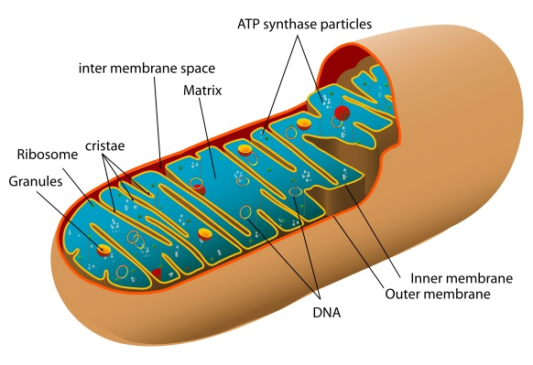
Other membranous structures in cell
Chloroplast
Mitochondria

Slide 8
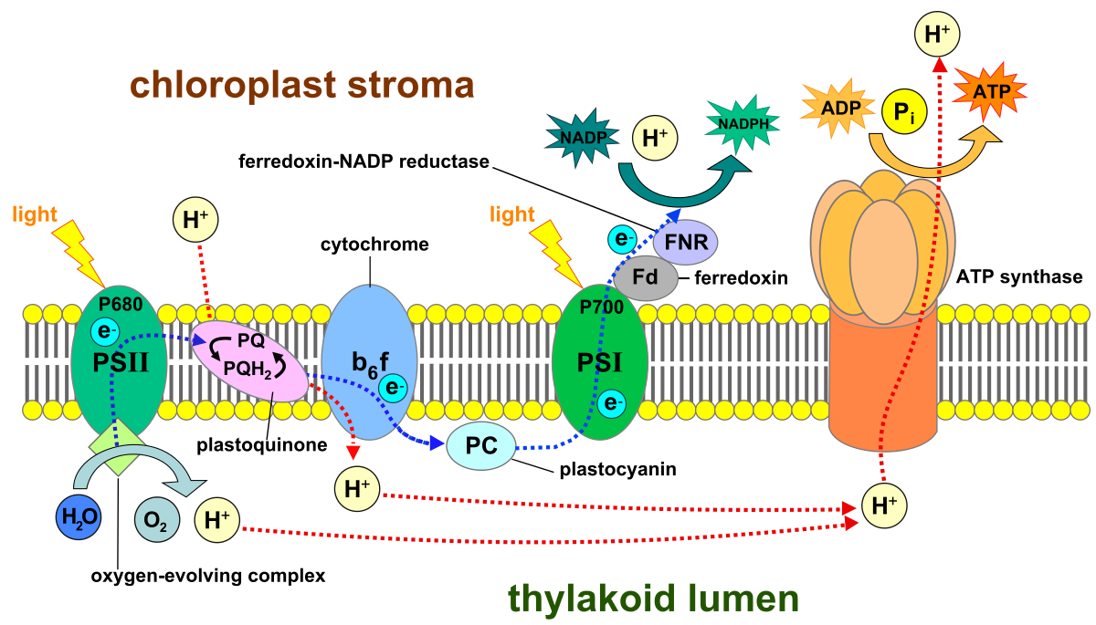

Slide 9

Photophosphorylation
Similarities and Differences between photophosphorylation and Oxidative phosphorylation
Features | Photo-phosphorylation | Oxidative phosphorylation
Electron flow
Series of membrane bound carriers
Ubiquinone, Cytochrome c, Iron-Sulphur clusters

Slide 10
Photophosphorylation
Similarities and Differences between photophosphorylation and Oxidative phosphorylation
Features | Photophosphorylation | Oxidative phosphorylation
Electron Donor | H₂O | NADH, FADH₂
Standard Reduction potential | 0.816 V | -3.20 V
Energy required to create a donor | Light | None

Slide 11
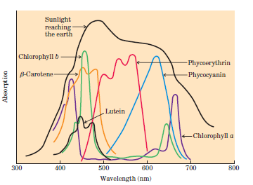
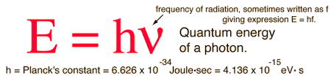
Light absorbing pigments
The most important light-absorbing pigments in the thylakoid membranes are the chlorophylls, green pigments with polycyclic, planar structures with Mg2+ occupies the central position.
The four inward-oriented nitrogen atoms of chlorophyll are coordinated with the Mg2+.
All chlorophylls have a long phytol side chain, esterified to a carboxyl-group substituent in ring IV.

Slide 12
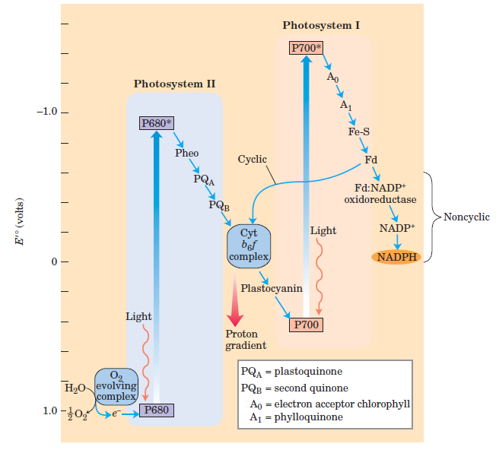
Non cyclic photophosphorylation in plants

Slide 13
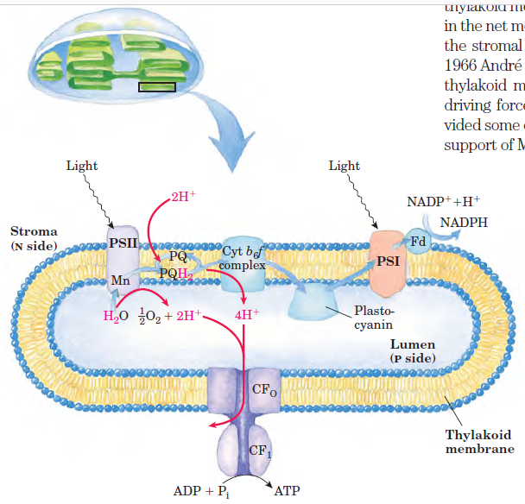

Slide 14
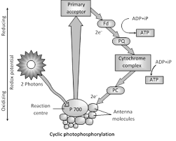

Slide 15
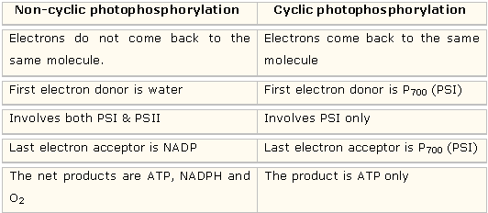

Slide 16
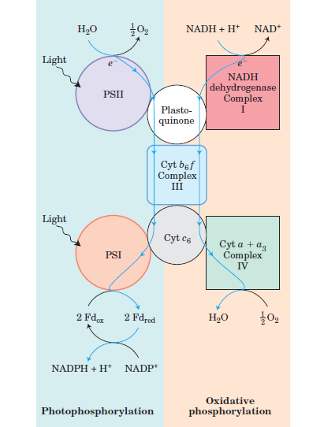
Summary

Slide 17
Photosynthesis in plants encompasses two processes:
the light-dependent reactions, or light reactions, which occur only when plants are illuminated
carbon-assimilation reactions (or carbon-fixation reactions), sometimes misleadingly called the dark reactions, which are driven by products of the light reactions.
In the light reactions, chlorophyll and other pigments of photosynthetic cells absorb light energy and conserve it as ATP and NADPH; simultaneously, O2 is evolved.
In the carbon-assimilation reactions, ATP and NADPH are used to reduce CO2 to form triose phosphates, starch, and sucrose, and other products derived from them.

